Slide 1

Beyond "How are you?”
Getting to the heart of the matter in sessions with families and students
Cassandra Fogelstrom, M.Ed., LSLS Cert. AVEd
Tele-intervention Specialist, Teacher of the Deaf
Department of Communicative Disorders and Deaf Education, Utah State University
Elizabeth Parker, M.Ed
Practicum Supervisor, Teacher of the Deaf
Department of Communicative Disorders and Deaf Education, Utah State University

Slide 2
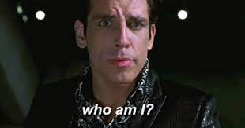

Slide 3
Webinar Expectations:
Be present- listen and think about how this applies to your life and/or career
Laugh at our jokes- (It’s ok, we’ll never know if you don’t)
Bring your life experience and background knowledge to the conversation
Keep learning today, tomorrow, the next day, and the day after that

Slide 4
“How Are You?”
Appropriate and polite question to ask
What are typical answers?
  “Great”
  “Fine”
  “Good”
    All one word answers!
What happens when we get these answers?
  “Not so good”
  “Actually, it’s been a bad week”
    We typically delve further to hear what the matter is
What is our purpose for this question?
  Most of the time, we actually want to know how a person is

Slide 5
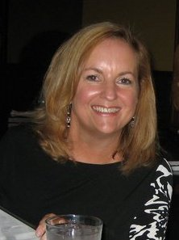
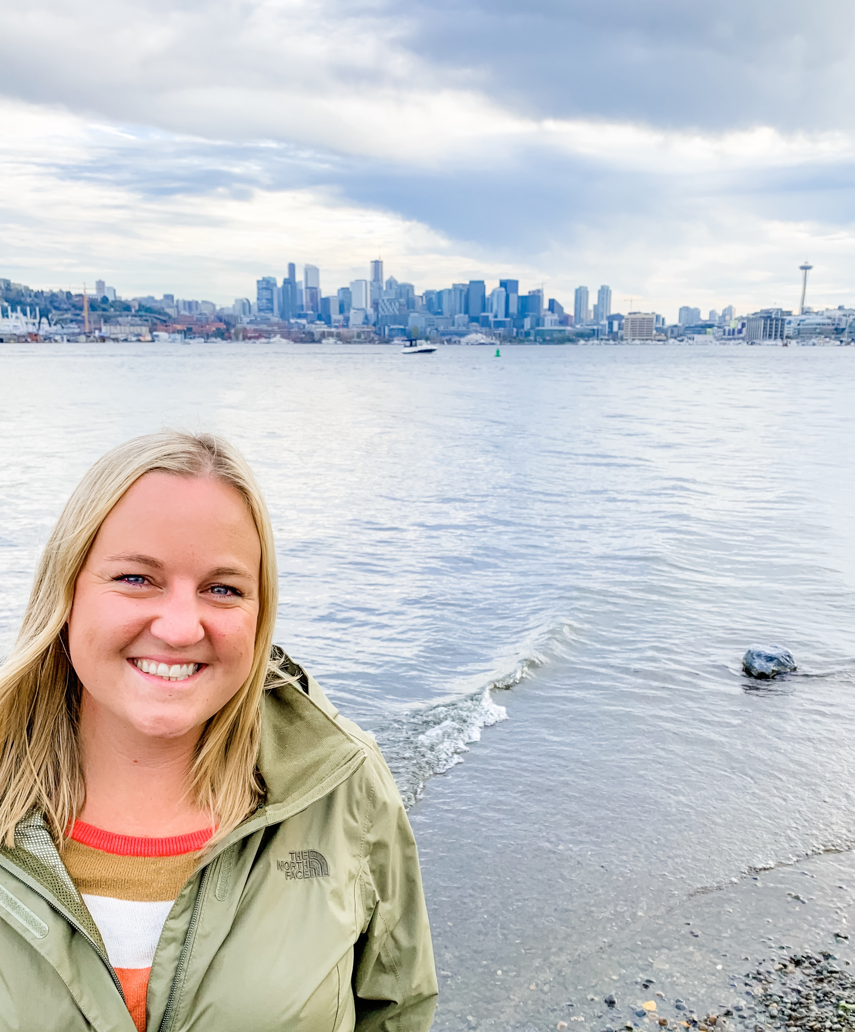
Who are we?
Liz Parker, M.Ed
  Teacher of the Deaf
  Currently works with graduate students
Cass Fogelstrom, M.Ed. LSLS Cert. AVEd
  Teacher of the Deaf
  Auditory Verbal Educator
  Currently provides Auditory Verbal Therapy for families via tele-intervention

Slide 6

“How Are You?”
Video #1

Slide 7
Video #1 Analysis
What do you know now that you didn’t know before?
What was the purpose of the question “how are you?”
“If you get the wrong answer, you asked the wrong question.” – Margot Butler
It’s time to start asking better questions

Slide 8
Types of Questions
Yes/No Questions vs. Open Ended Questions
What happens when we ask the question “What is it?”
  One word answer
  Maybe only one “right” answer
What happens when we leave it open ended.. “Tell me about…”
  Abundance of “right” answers
  Different types of language structures, vocabulary usage, sequencing, etc.

Slide 9
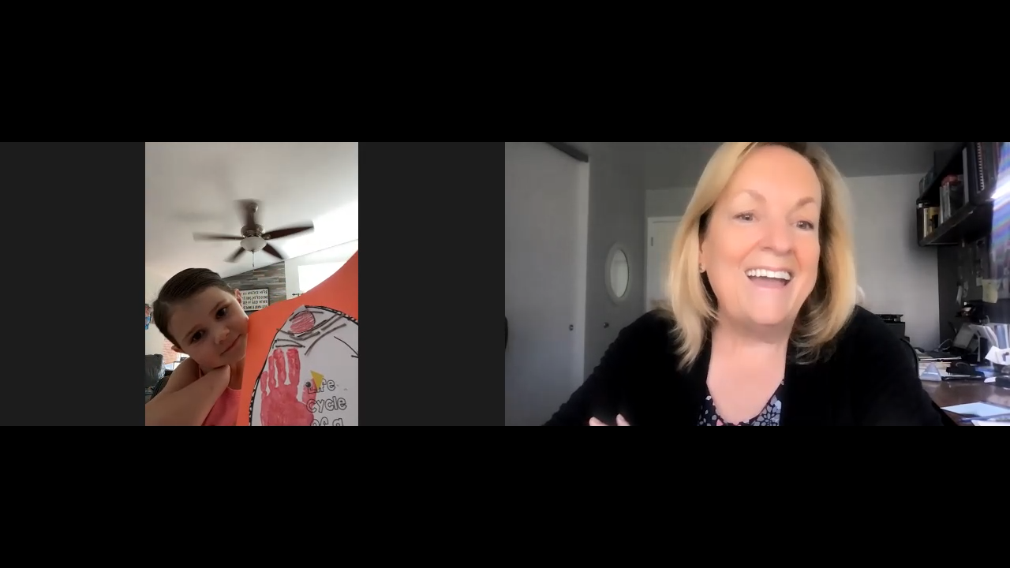
“Tell Me About…”
Video #2

Slide 10
Video #2 Analysis
What type of language did we get?
How did the child feel?
What would have happened if we just asked “What is that?”

Slide 11
Types of Questions (cont.)
Open Ended “Positive” Question
  Tell me about a “win”
  What was something funny that happened this week?
  Tell me about something that was exciting
  What made you go “whoa”?
Delve into something deeper
  Was there anything that was a little bit challenging this week?
    Easier to talk about things that were difficult after they’ve discussed the positives

Slide 12
What do we get out of this?
After open ended “positive” questions:
  I get to hear amazing stories
  I get to share in their victories
  I get to laugh at their “funnies”
  I get to hear what was important to them
  I get to learn where they made progress
After asking about challenges:
  I get to brainstorm ways to conquer those challenges
  I get to hear what their priorities are
  I get to learn about new goals that students/parents might want to work on
  I get to help them problem solve
  I (diagnostically) use these answers to teach/coach through the harder situations

Slide 13
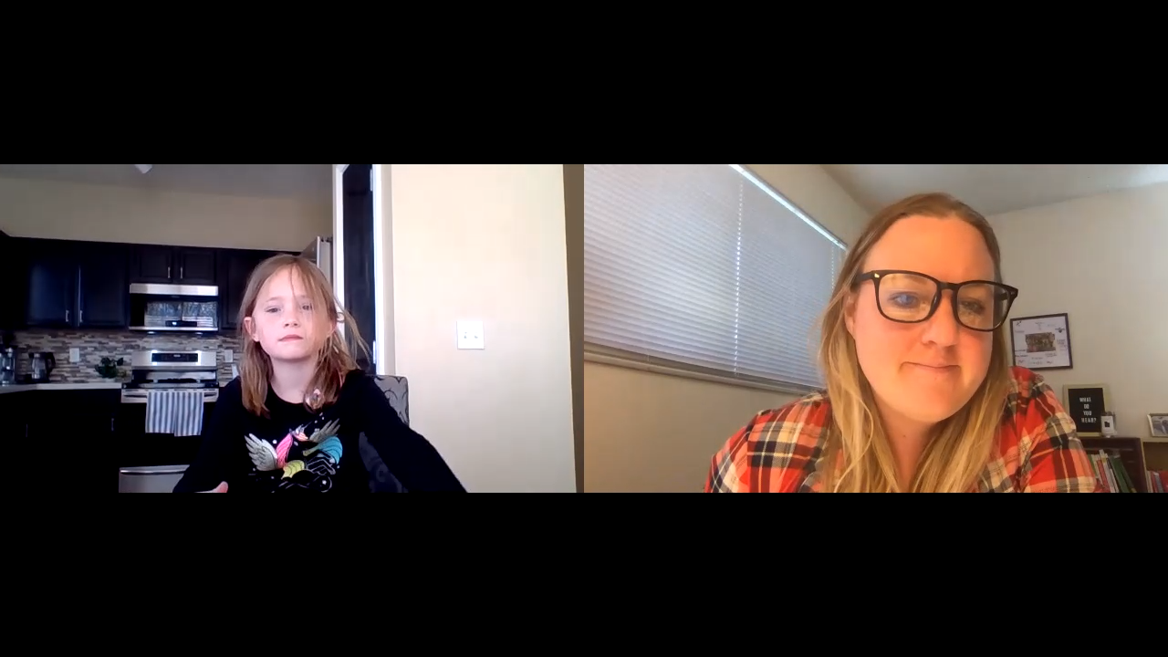
“Tell me what was exciting this week..”
Video #3

Slide 14
Video #3 Analysis
What type of language did we get?
How did the child feel?
What did we get out of this?
  (Hint: Look at slide 12;)

Slide 15
Advantages
Anticipating that these open ended questions will come every week:
  I notice more during the week
  I’m taking time to see things that are positive in my life
  I’m in the habit of noticing when my child says something funny
  I notice when someone conquers a challenge
Turn those answers/challenges into upcoming goals
Diagnostic teaching (adjusting our lesson plans or discussion topics)
Problem solve together

Slide 16
What Questions Can YOU Ask?
Start thinking about how you phrase your questions
How can you use this throughout your life?
  Sessions
  Meetings
  Time with family
  Meeting someone new
What is your purpose?
  Are you greeting someone politely? Or… do you you really want to know more about that person?

Slide 17
Let’s Keep the Conversation Going...
Liz Parker
Liz.parker@usu.edu
Cass Fogelstrom
Cassandra.parker@usu.edu

Slide 18
Thank You!

